Slide 1

The Funding & Tenders Portal: what you need to know
Olivier Marganne
External Service Provider in RTD.H.3
Common Implementation Centre – Business Processes

Slide 2
Personalised services
Personalised access to the Funding & Tenders Portal is based on 3 elements:
Each user is supposed to have a unique EU Login account,
which is the unique identifier for persons
(linked to their professional email address).
Each EU Login account is linked to one (or more) PIC number(s),
which are the unique identifier for organisations.
Each EU Login account is linked to all the roles that the user has in projects
and/or organisations through IAM.
LEAR
AccAd
LSIGN
FSIGN
PCoCo
CoCo
PaCo
TaMa
TeMe
PLSIGN
PFSIGN
PAuCo
AuCo

Slide 3
1. EU Login
Creating your personal account

Slide 4
Create a new EU Login account
Click on the "Register" button
Enter your name & (professional) e-mail address
Click on the link you receive via e-mail
Set up your password
Single sign-on: 1 EU Login account = 1 e-mail address = 1 person
DO NOT SHARE YOUR EU LOGIN CREDENTIALS!

Slide 5
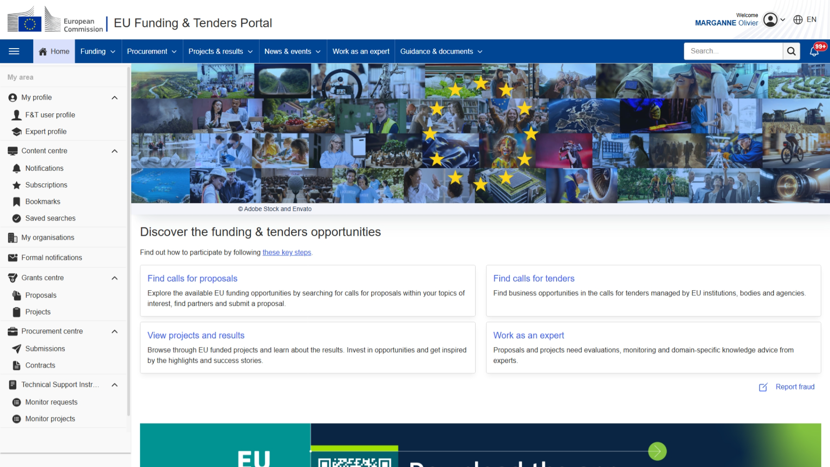
When logged in in the F&T Portal
Personalised access
to the user account
Personalised access
to the IT tools

Slide 6
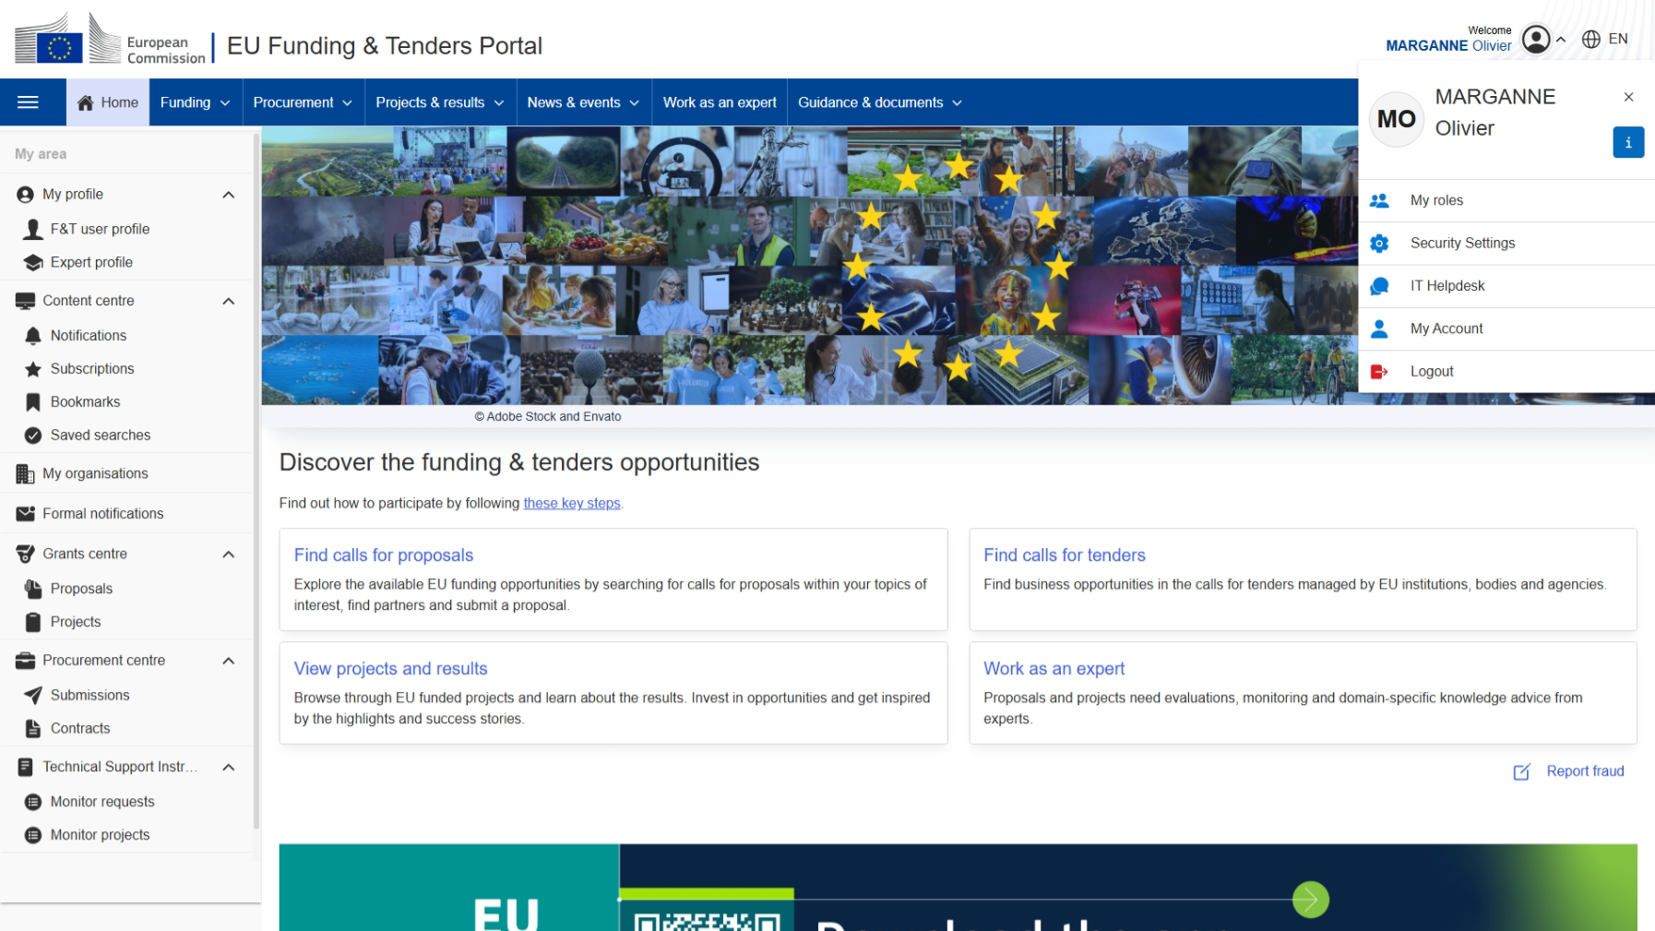
Manage your EU Login account
Manage your EU Login account

Slide 7
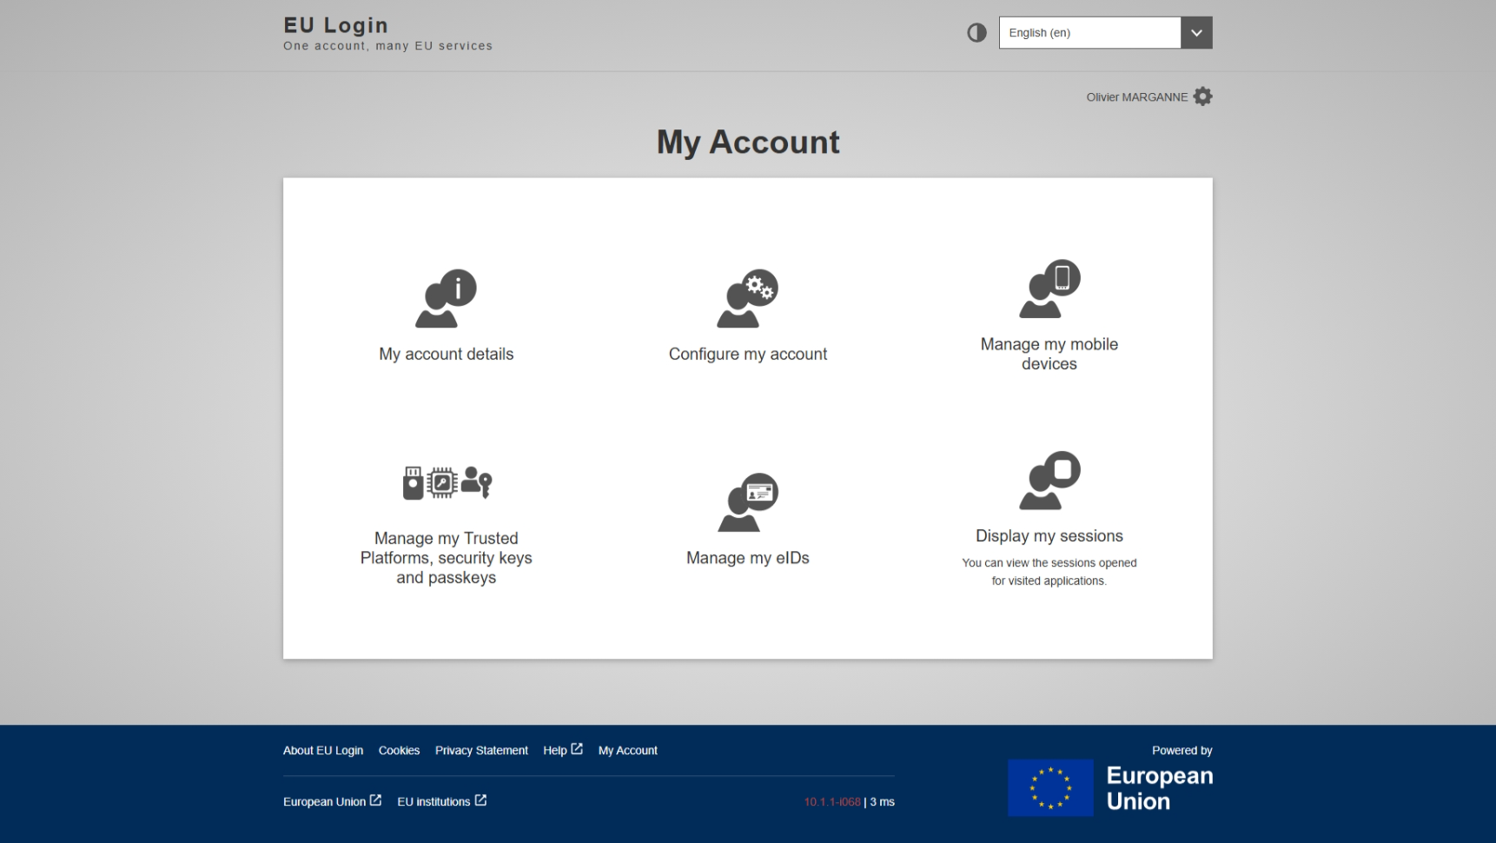
EU Login main screen
Click on the gear icon
if you want to change your EU Login password

Slide 8




Enable 2-factor authentication
2FA is the use of a physical device to confirm an online connexion attempt:
Two factors = something that you know (password) + something that you own (a device)
Using a combination of username & password is no longer secure enough!
Mobile device
(smartphone, tablet)
with EU Login app
Special USB security key or trusted platform (TPM)
eID – national ID card providing digital identification
Passkey
on your mobile device
or computer

Slide 9
Enable 2FA: Security Settings
Enable 2FA via "Security Settings"

Slide 10
Enable 2FA: the process in a nutshell
Add the second factor used for authentication (a device, etc.)
Set up the 3 security questions
You're set!
Next time you log in, select your preferred 2FA method in the EU Login dropdown menu

Slide 11
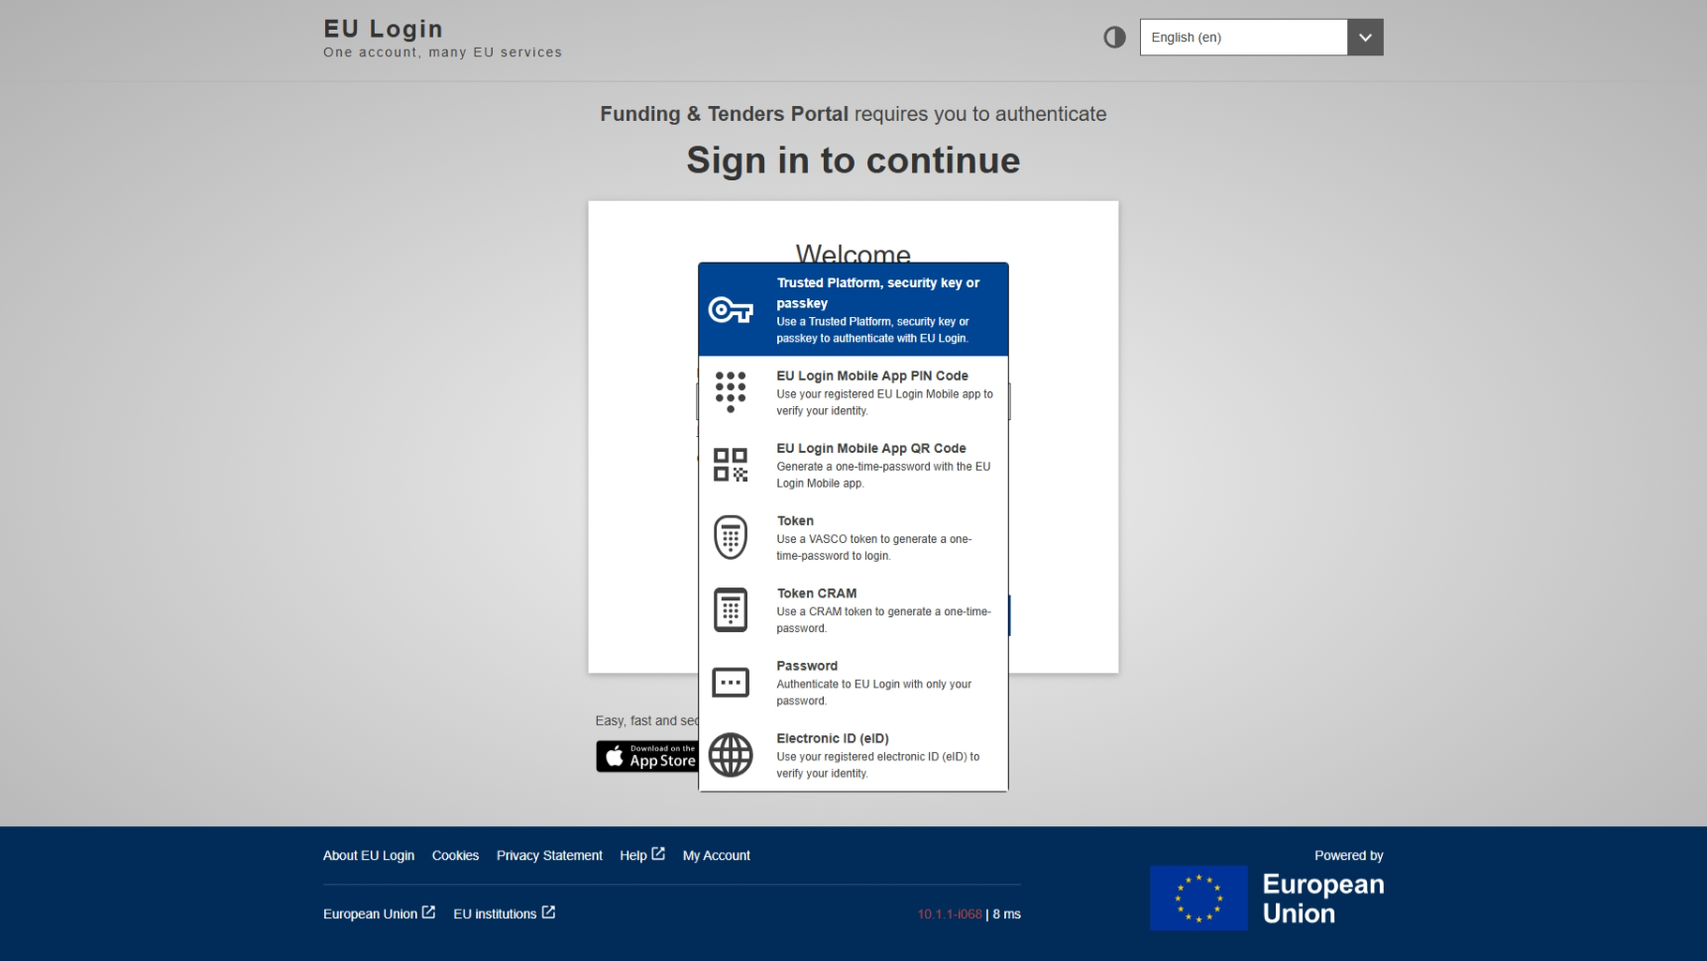
Login using 2FA

Slide 12
More info about 2FA
The video tutorials:
https://ec.europa.eu/info/funding-tenders/opportunities/portal/screen/support/videos/support
The IT How To wiki:
https://webgate.ec.europa.eu/funding-tenders-opportunities/x/LQKI
The helpdesk:
https://ec.europa.eu/info/funding-tenders/opportunities/portal/screen/support/helpdesks/contact-form
The webinars:
https://ec.europa.eu/research/participants/docs/h2020-funding-guide/other/event260513.htm
https://ec.europa.eu/research/participants/docs/h2020-funding-guide/other/event251203.htm
https://ec.europa.eu/research/participants/docs/h2020-funding-guide/other/event250429.htm

Slide 13
2. Participant register
Participant Identification Code (PIC)

Slide 14
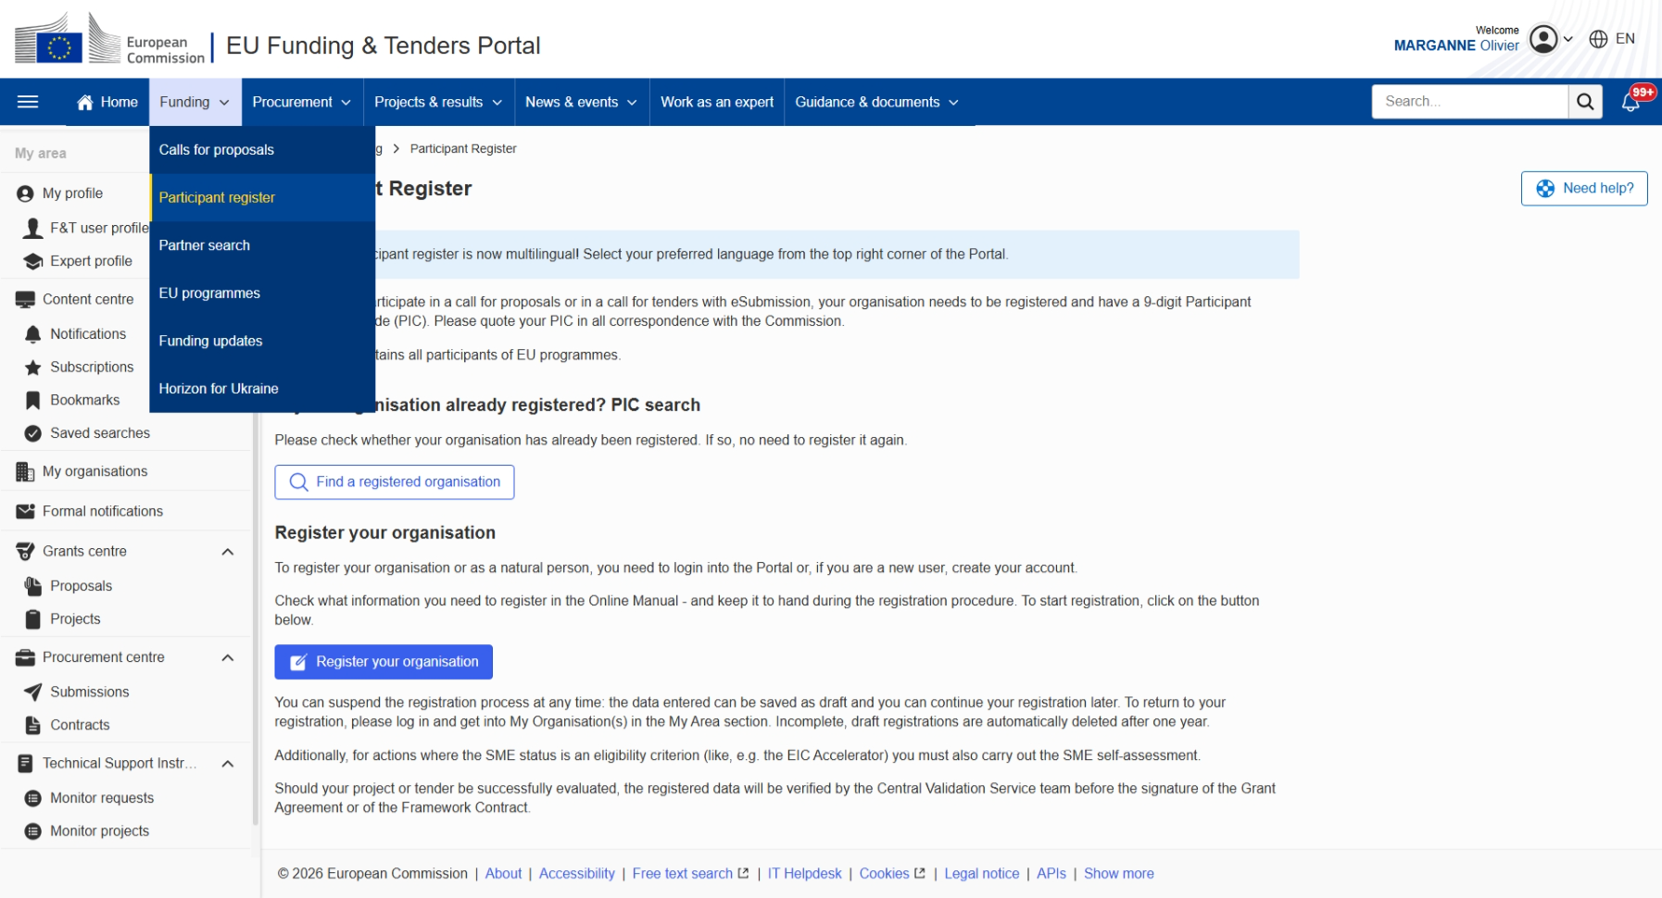
How to access the Participant Register

Slide 15
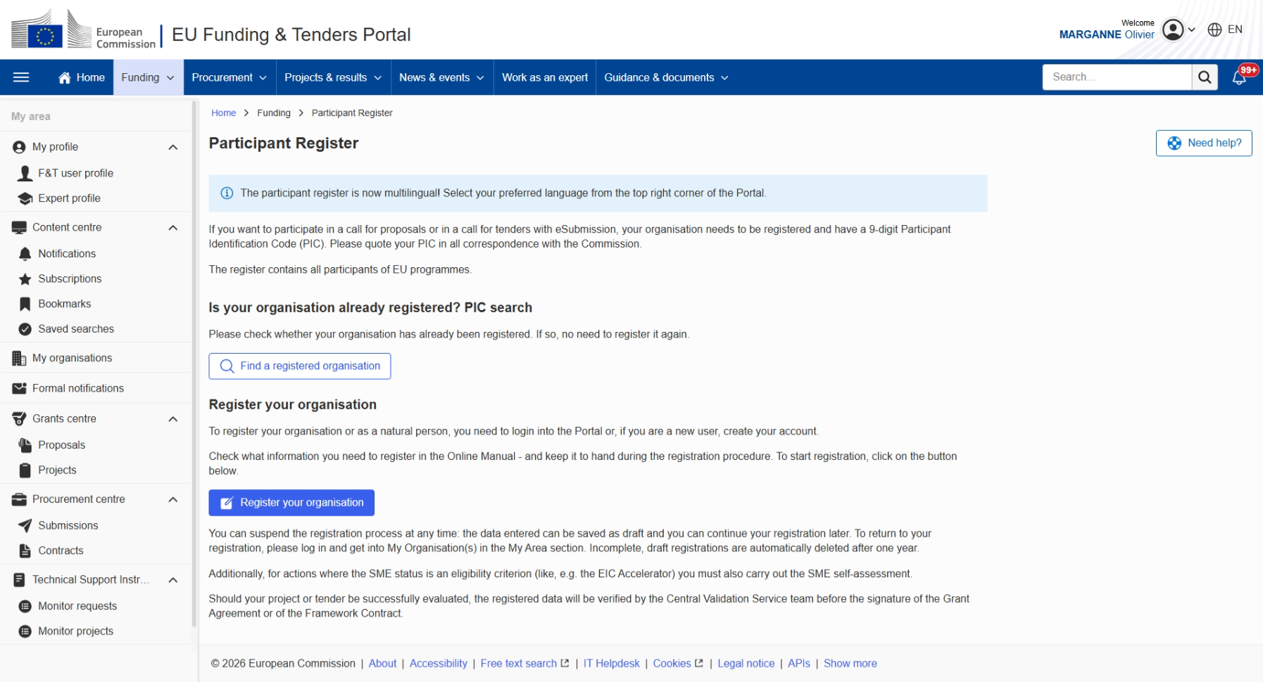
Participant Register
If your organisation is already registered
If not, start registering

Slide 16
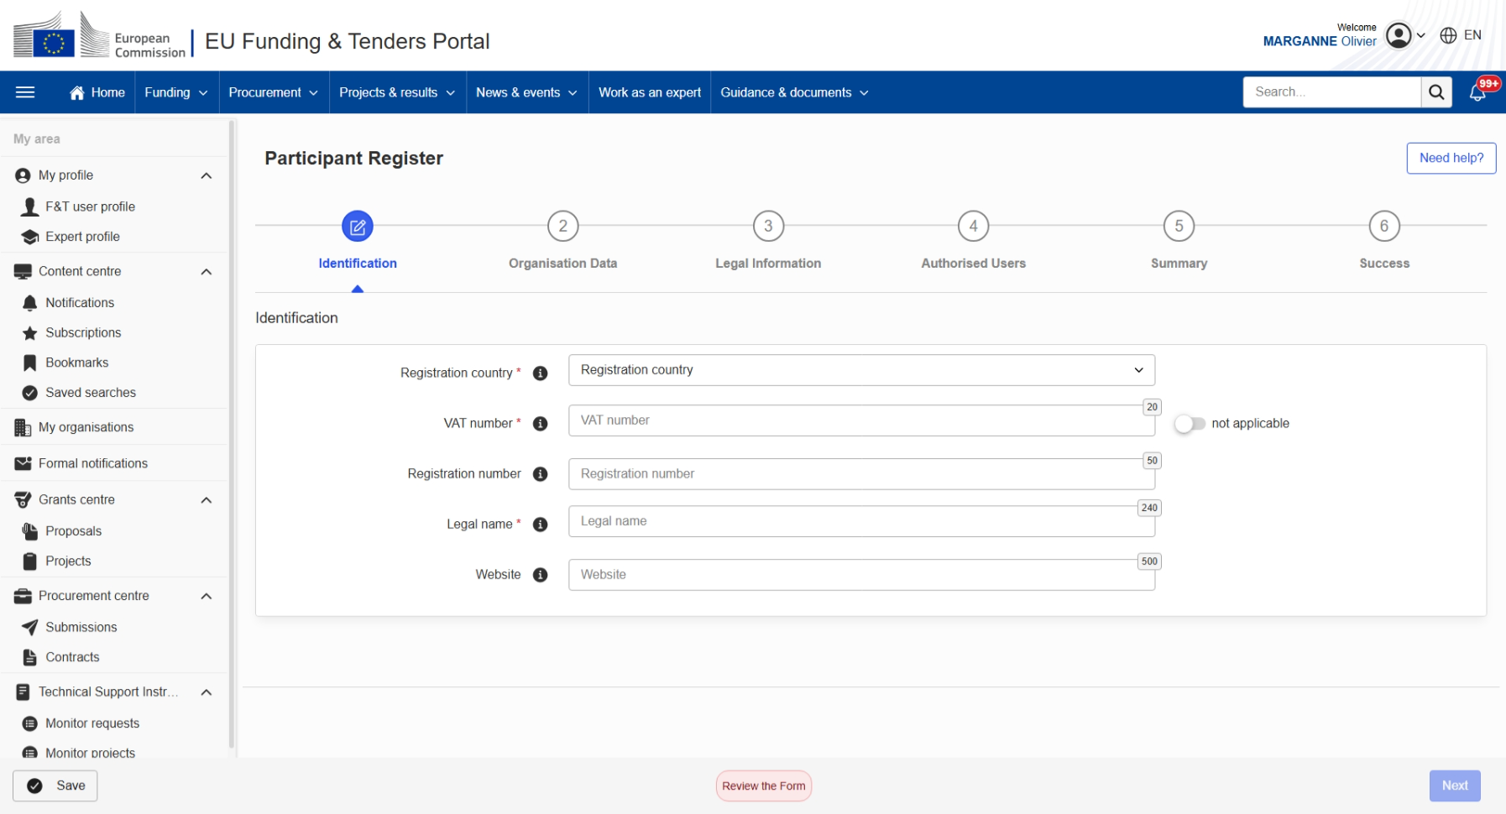
Participant Register: "metro line"
Name & email address of the Self-Registrant

Slide 17
When registered in the Participant Register…
When the registration is completed,
the PIC (status 'Declared') can be used to submit proposals
The person who registers an organisation receives the Self-Registrant role:
this person is the contact person with the Commission services
for this organisation until a LEAR is appointed
When the organisation has to sign its first Grant Agreement or Contract,
the legal validation must be done – only once: it is reused for future participations
in EU grant and procurement actions
All contact with the Central Validation Services must take place
inside the Participant Register
Validation is required for all beneficiaries and affiliated entities

Slide 18
3. Search funding & tenders
Browse the funding opportunities & find partners

Slide 19
EU funding: basic structure
Funding & Tenders Portal
Programme
Programme
Call
Call
Call
Call
Call
Topic
Topic
Topic
Topic
Topic
…
…
…
Topic
Topic
Topic
Topic
…

Slide 20
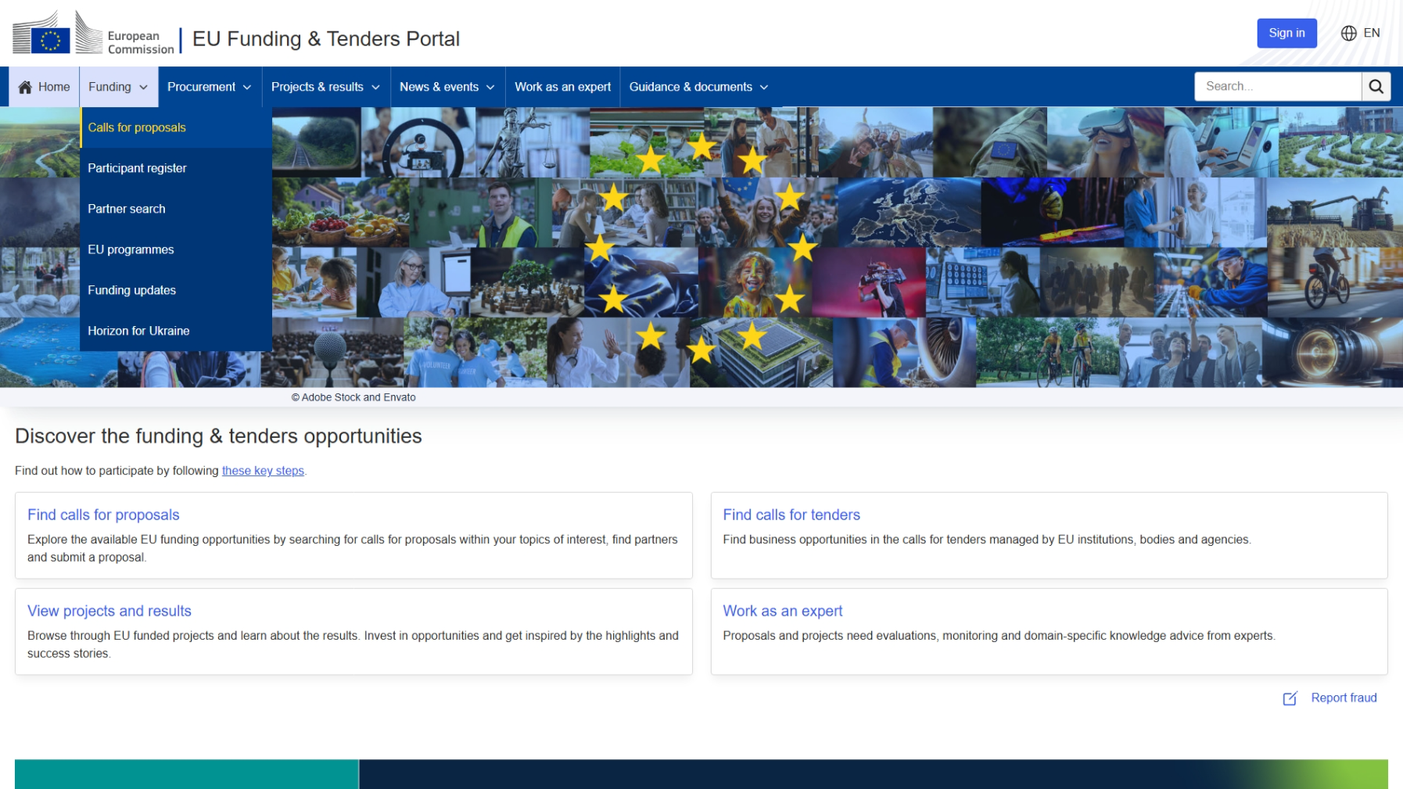
Funding vs. Procurements (or calls for proposals vs. calls for tender)
Grants are non-profit opportunities to have activities funded by the EU
Tenders are calls from the EU to buy goods or services at a fixed price

Slide 21
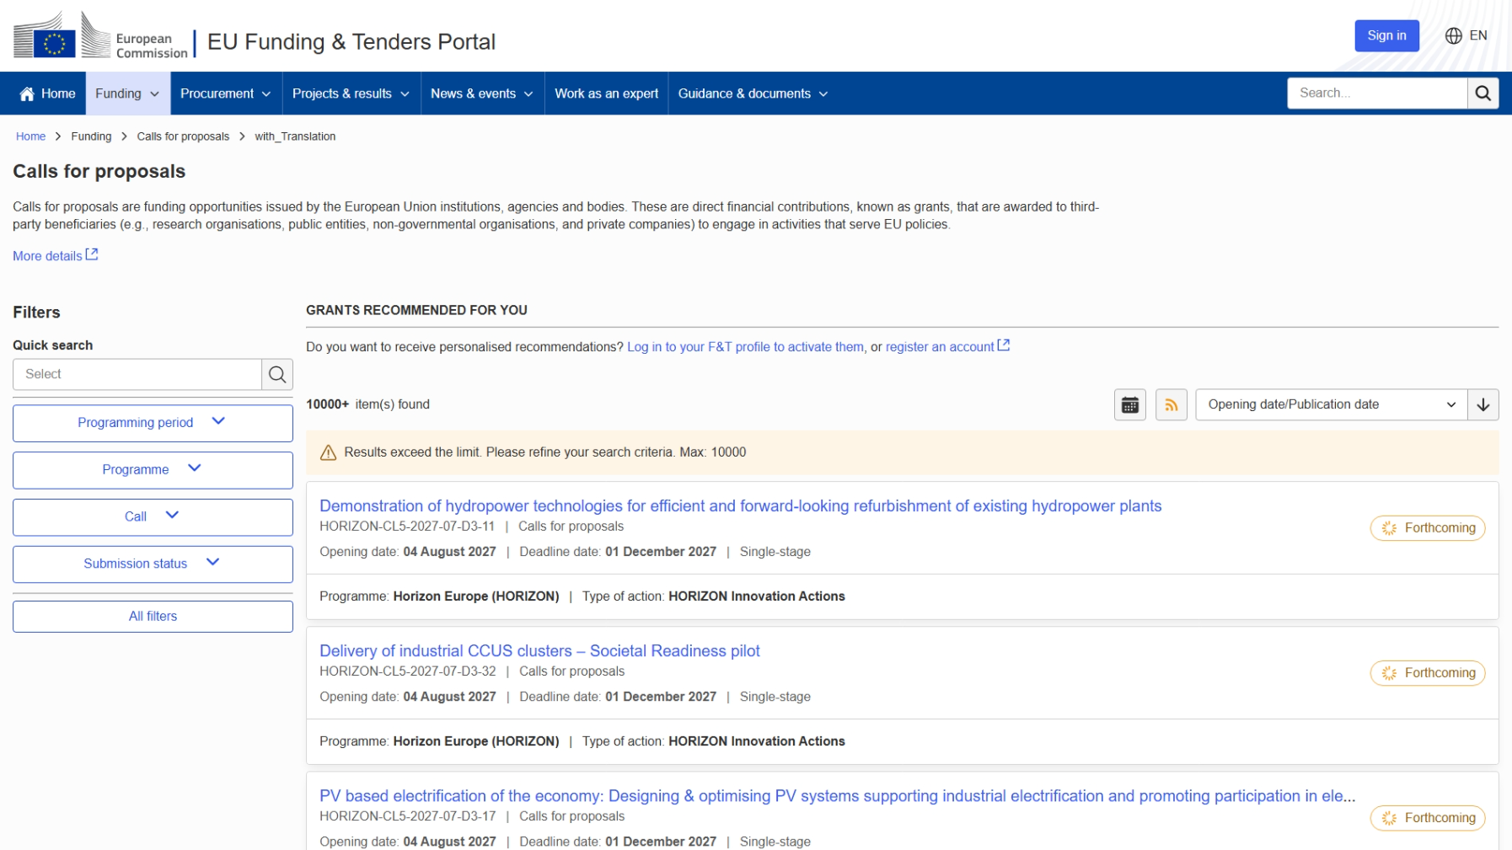
Search for calls for proposals
Use the filters to narrow down your search results

Slide 22
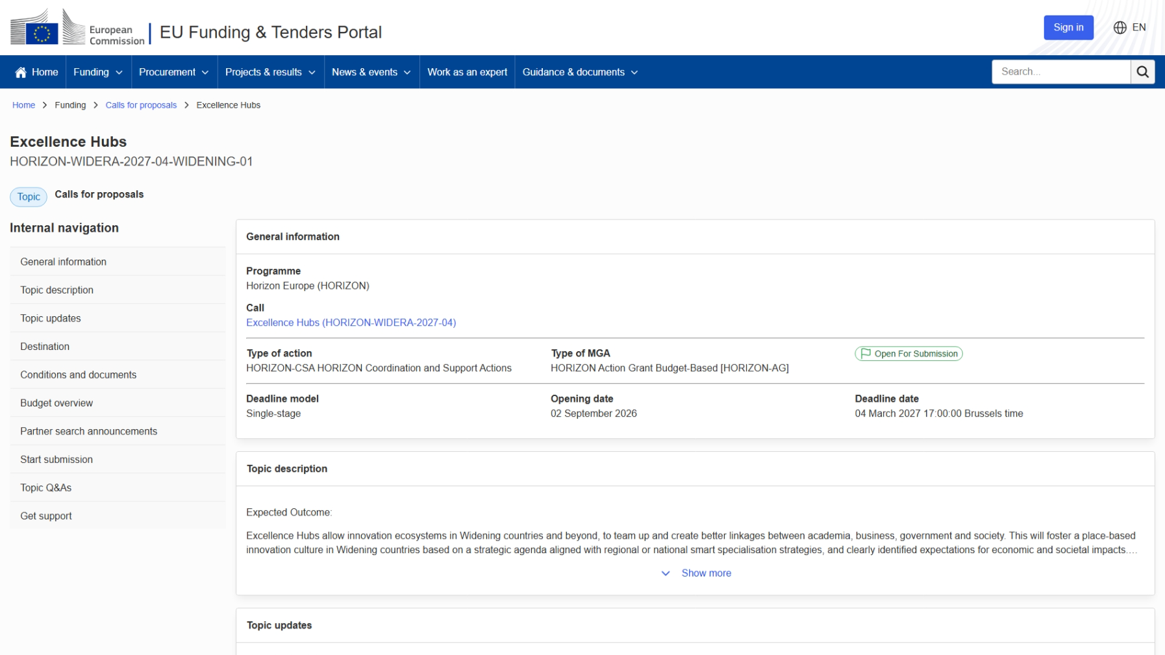
Example of a "topic page"
Descriptive information about the topic
See partner search announcements
Start submitting a proposal
Find help related to this topic

Slide 23
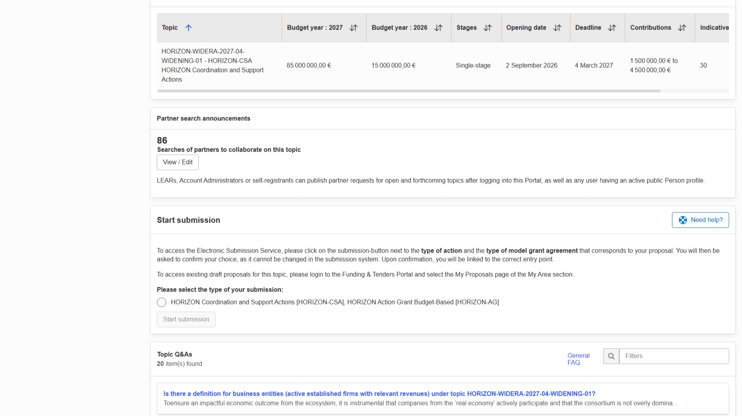

How to access the Partner Search for a specific funding opportunity

Slide 24
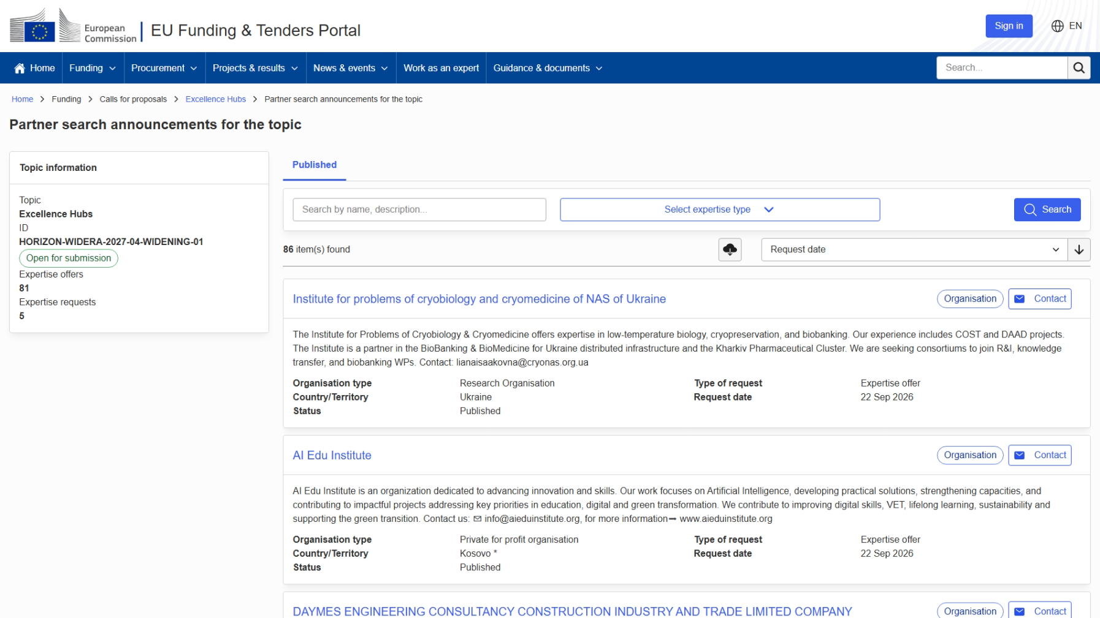
Partner search announcements for the topic
Creating partner search announcements linked to a topic
can only be done by the LEAR or the Account Administrators!
(or Self-Registrant if the organisation has not yet been validated)
LEAR
AccAd

Slide 25

Another way to access the Partner Search
Another way to search for partners

Slide 26
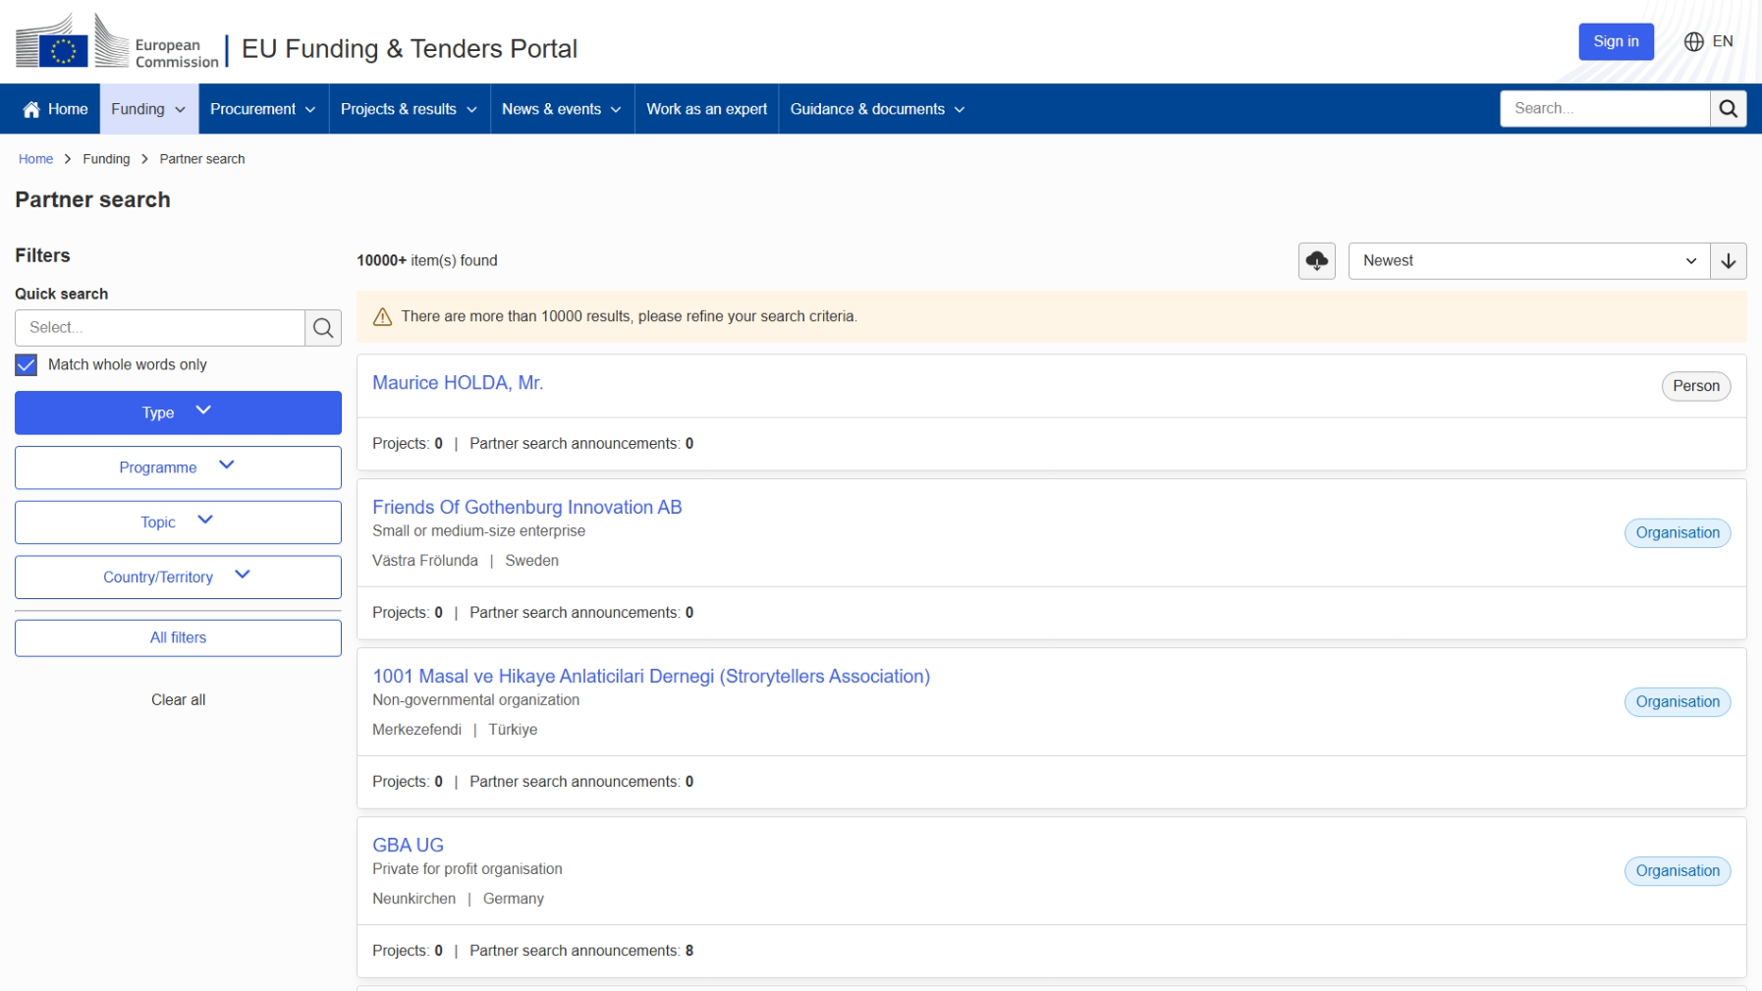
General Partner Search page

Slide 27
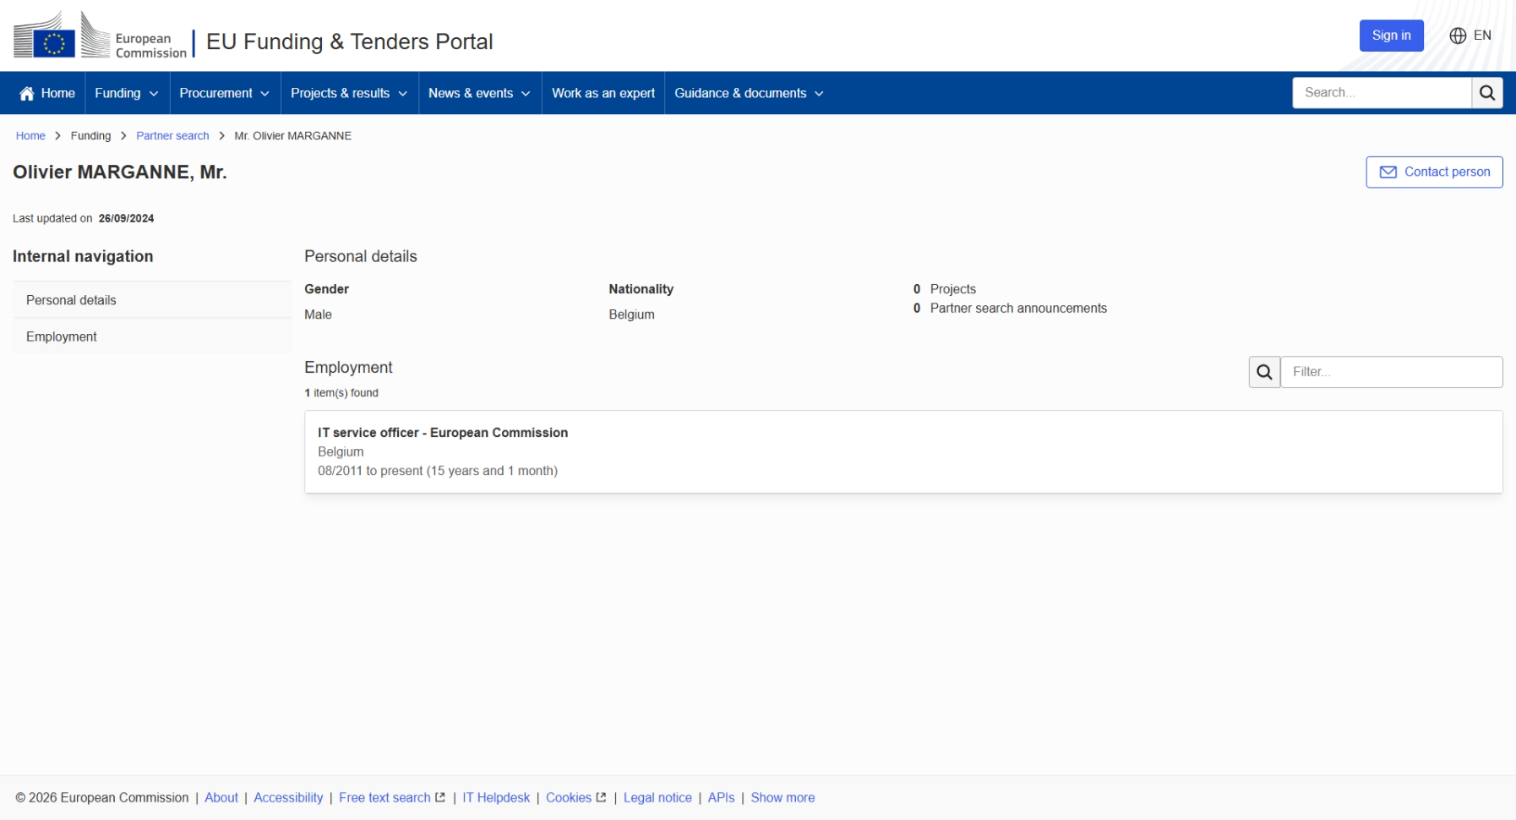

Person profile visible publicly
Contact that person

Slide 28
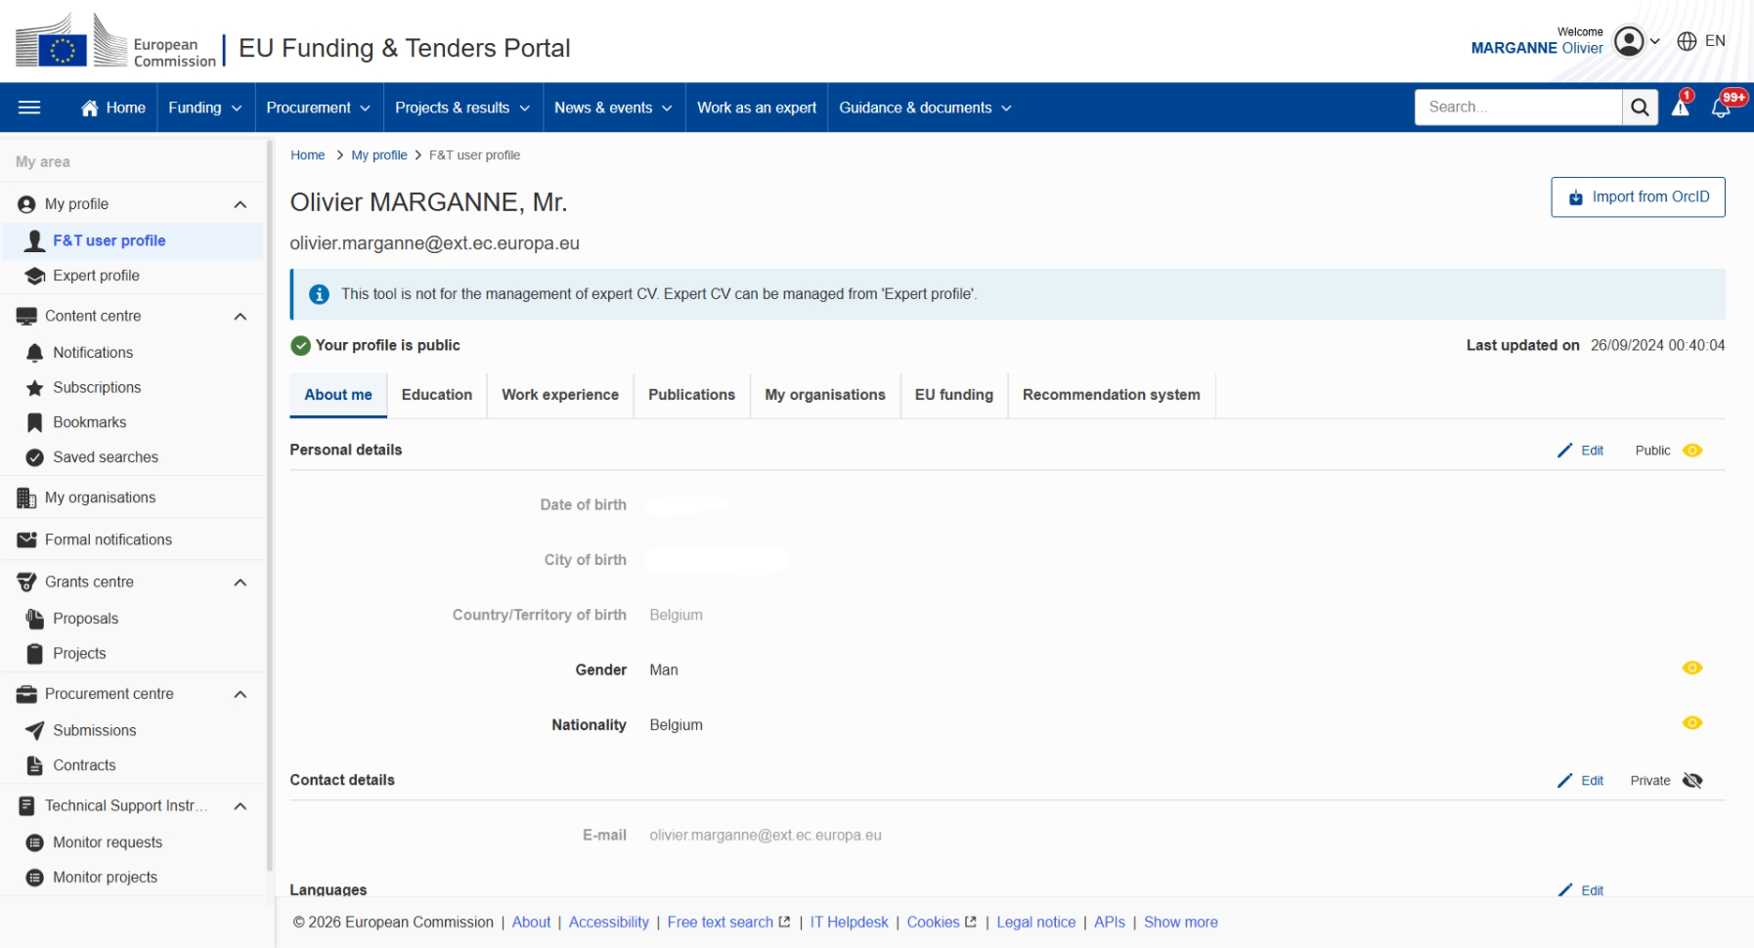
Example of a person profile
Edit the information visible on your person profile
Decide if a whole section should be visible or not, or fine-tune the visibility down to every individual field

Slide 29
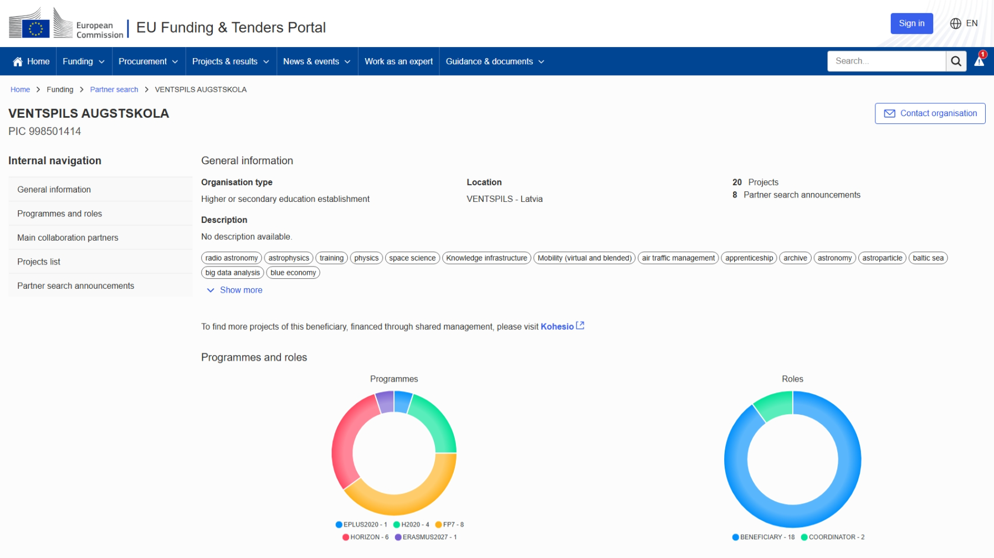
Example of an organisation profile
"Organisation profile"
Descriptive information about the topic
Information about past participations in EU funding programmes
Partner search announcements

Slide 30
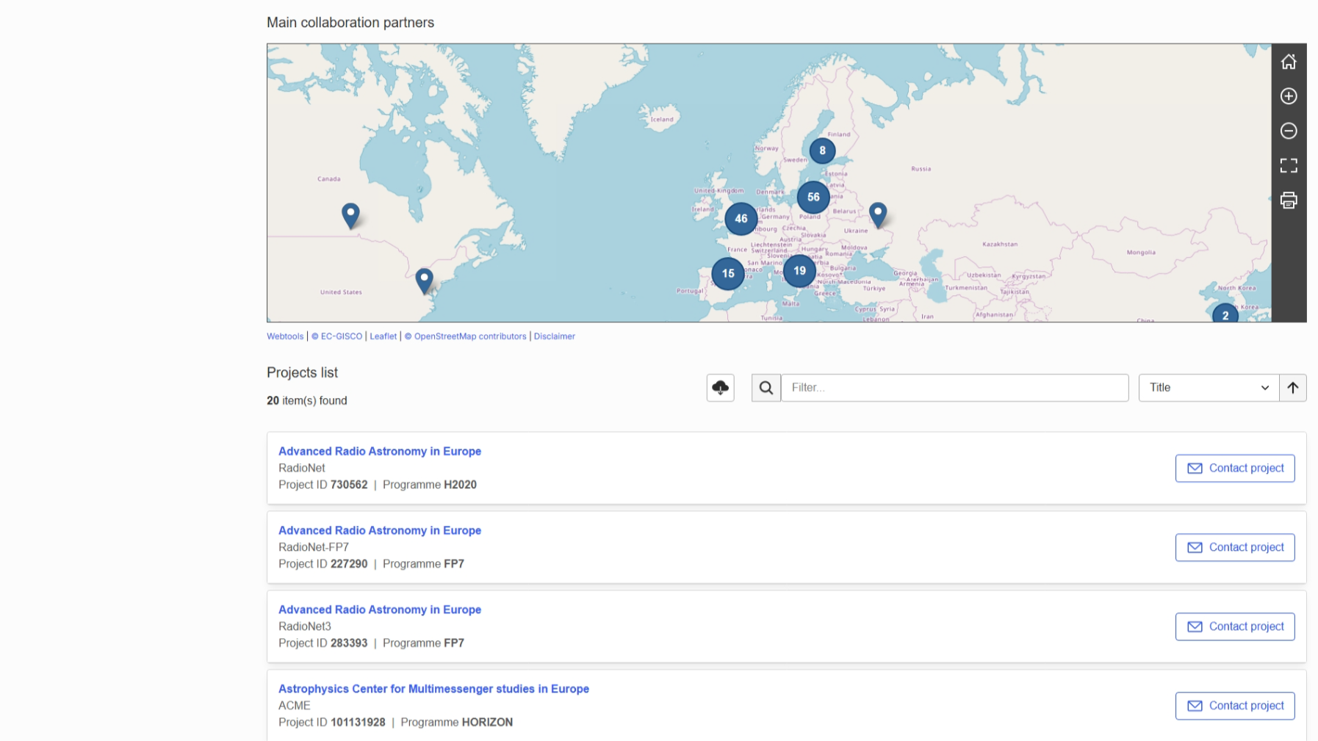
Example of an organisation profile (continued)
"Organisation profile"

Slide 31
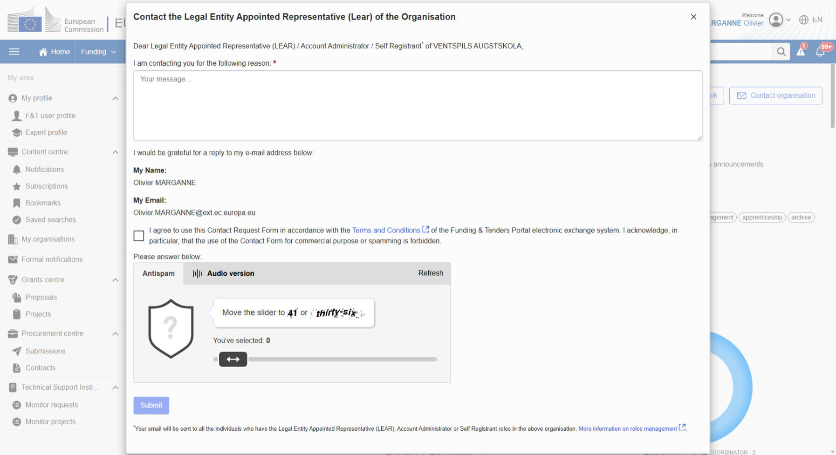
Contact form
Info of the sender – no personal information
of the recipient is disclosed through this form!
Using the contact forms is subject to the Terms & Conditions of use of the F&T Portal; any abuse may lead to sanctions!!
Mandatory captcha to minimise risks of abuse through bots

Slide 32
Spam/phishing: what to do?
As a user, there is no obligation for you to reply to contact attempts!
If you have any doubt, please remember that:
  The EC services never ask for any sensitive information via email
  Your personal information is never disclosed to the sender
  A copy of every F&T Portal notification received via email
  is available through your notifications on the F&T Portal itself
Do not forget to activate 2-factor authentication for increased security!
 https://ec.europa.eu/info/funding-tenders/opportunities/portal/screen/support/faq/7942

Slide 33
View your notifications

Slide 34
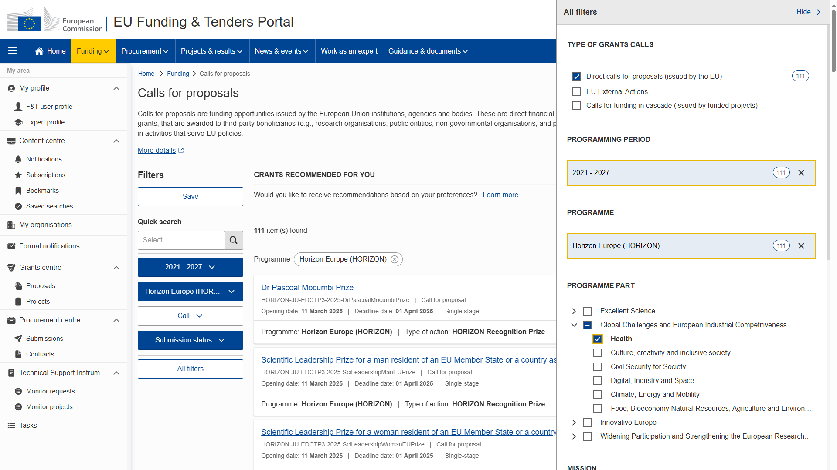
Client centricity improvement: recommendations

Slide 35
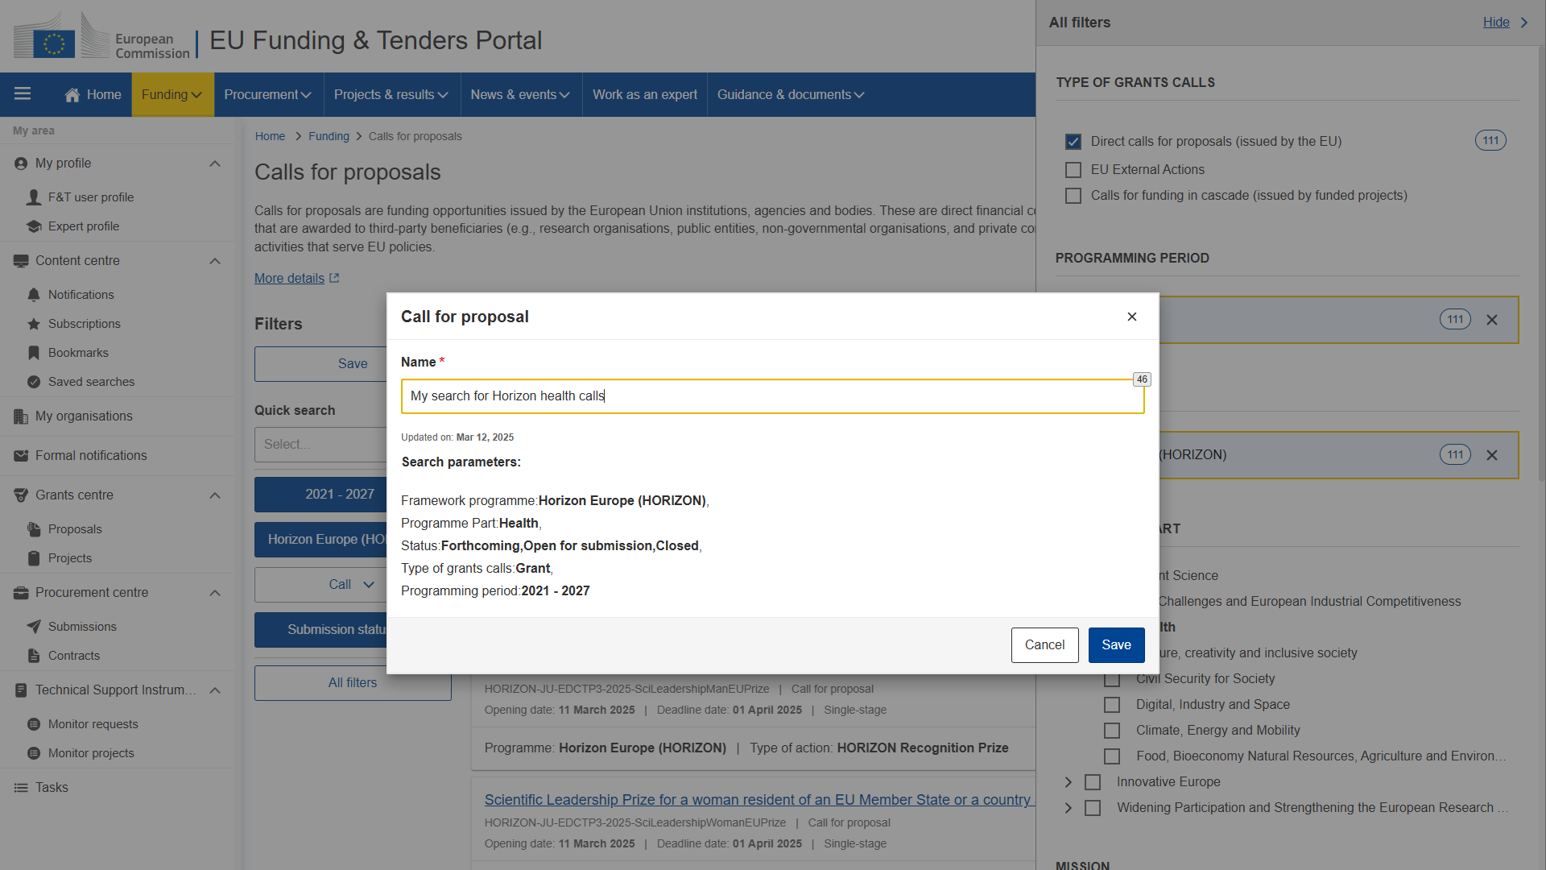

Slide 36
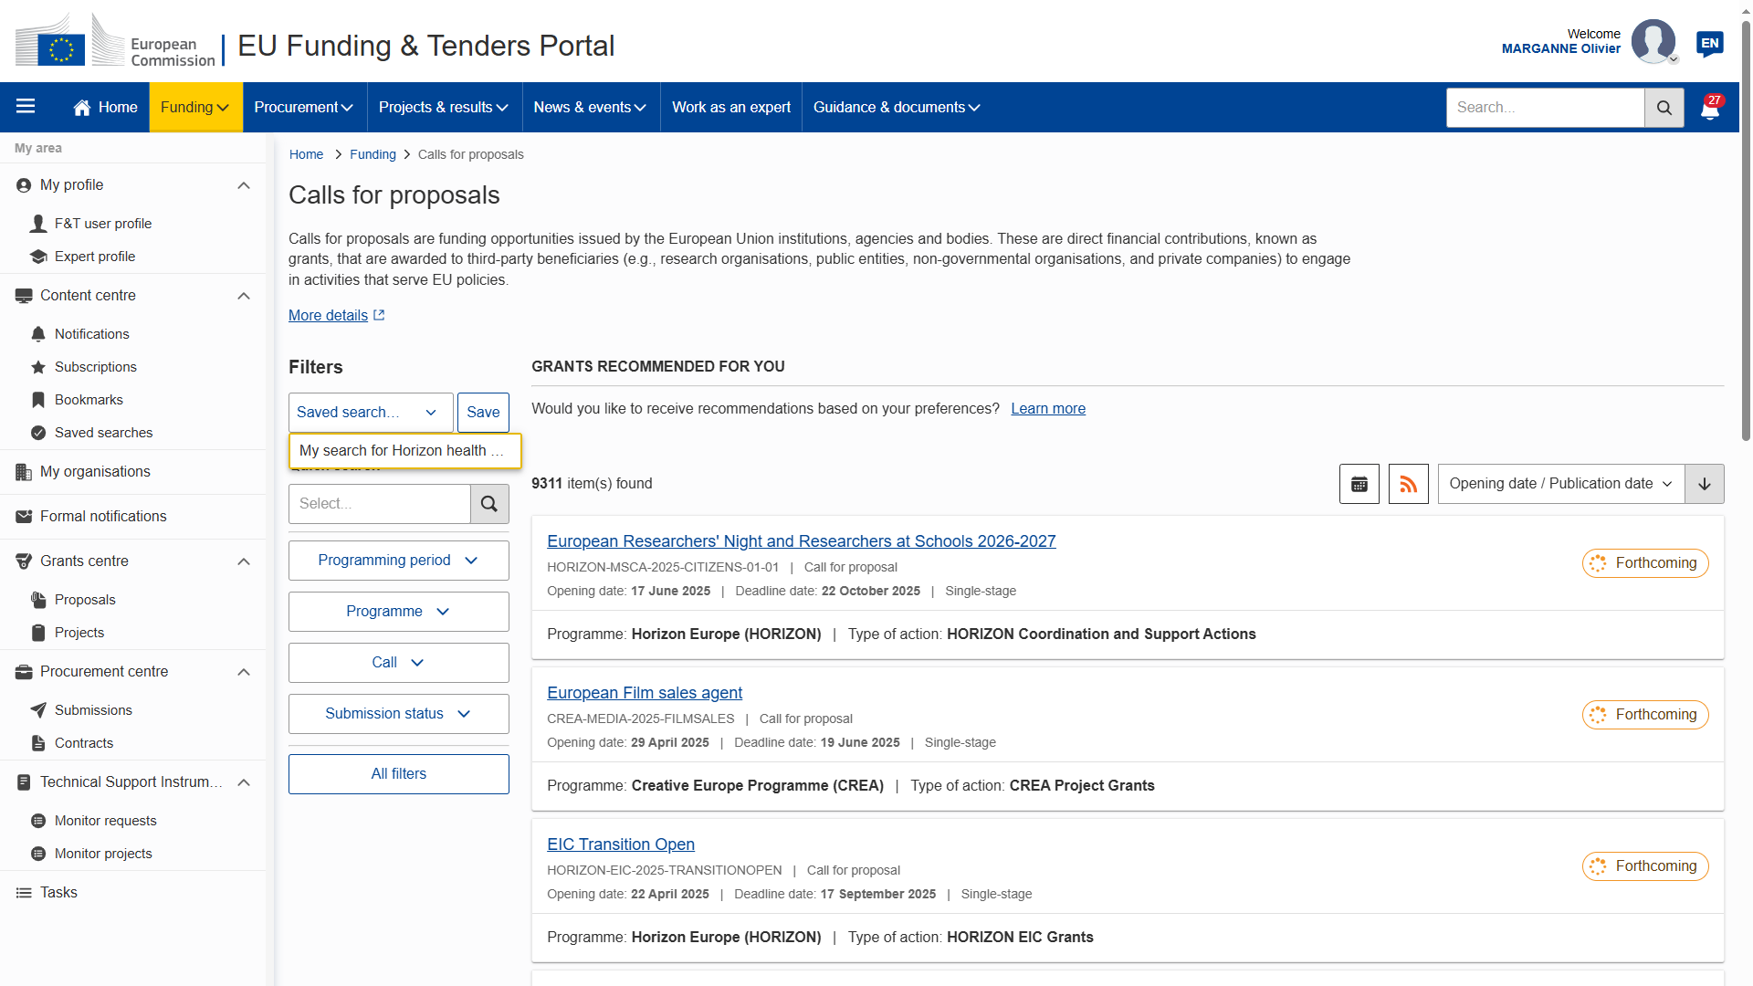

Slide 37
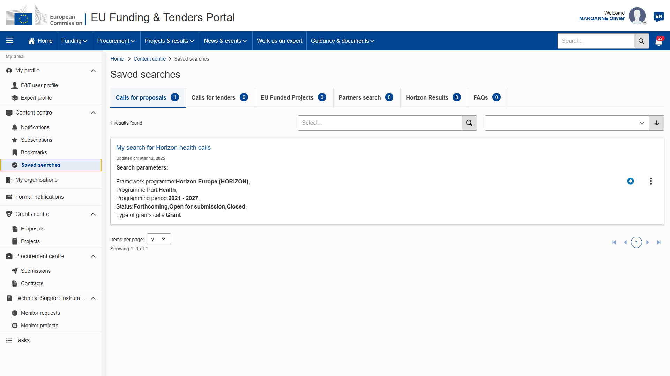

Slide 38
Content centre: …but wait, there's more!
Calls for proposals
Calls for tenders
EU funded projects
Organisations
Persons
Horizon Results
FAQs
News
Events

Slide 39
4. Submit your proposal
Basic rules of drafting a proposal

Slide 40
Preparing & managing your proposal
To start preparing your proposal, you need to go on the topic page itself
Managing your proposal: Draft / Submitted / Refused proposals are available under
My Area → My Proposals
Part A (to be filled in directly online) — contains administrative information
about the applicant and budget for the project. (Mandatory)
Part B (to be downloaded from the Portal Submission System, completed
and then assembled and re-uploaded as PDF in the system)
— contains the description of the action; (Mandatory)

Slide 41
Looking one step ahead: grant preparation
Some people nominated during the proposal submission phase
will have a role to play in the project when the grant preparation is reached:
The proposal initiator will automatically be recognised
as the Primary Coordinator Contact
The "Main Contacts" of the participating organisations identified
during proposal submission will become Participant Contacts
Roles are never definitive! It will be possible to change afterwards if needed.

Slide 42
The Identity and Access Management
Organisation roles
Project roles
Audit roles
LEAR
AccAd
PCoCo
CoCo
PLSIGN
PFSIGN
Coordinating
beneficiary
PAuCo
AuCo
LSIGN
FSIGN
TaMa
TeMe
LEAR
AccAd
PaCo
PLSIGN
PFSIGN
Participating
beneficiary
PAuCo
AuCo
LSIGN
FSIGN
TaMa
TeMe
 https://webgate.ec.europa.eu/funding-tenders-opportunities/display/OM/Roles+and+access+rights

Slide 43
"Who can do what": basic principle
Manage the organisation's data
LEAR
AccAd
LSIGN
FSIGN
Manage your projects
PCoCo
CoCo
PaCo
TaMa
TeMe
PLSIGN
PFSIGN

Slide 44
Important remarks
Only the LEAR and Primary Coordinator Contact
are defined/modified by the Commission.
Only the LEAR and Primary Coordinator Contact roles are unique.
There is no technical limitation in the amount of other roles
(you may appoint as many or as few as needed).
One person can have several roles at the same time.
Minimum configuration:
LEAR
PCoCo
PCoCo
(or )
LEAR
PaCo
PLSIGN
PFSIGN
Organisation roles
Project roles

Slide 45
List of all the roles linked to this EU Login account

Slide 46
Projects & results
Discover funded projects

Slide 47
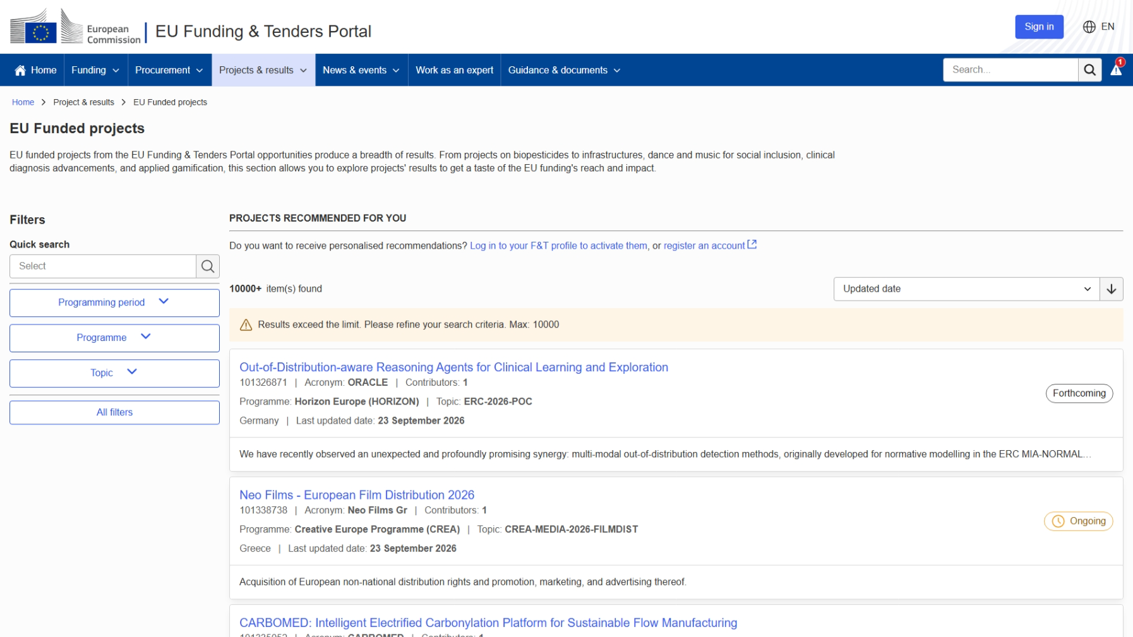
EU funded projects

Slide 48
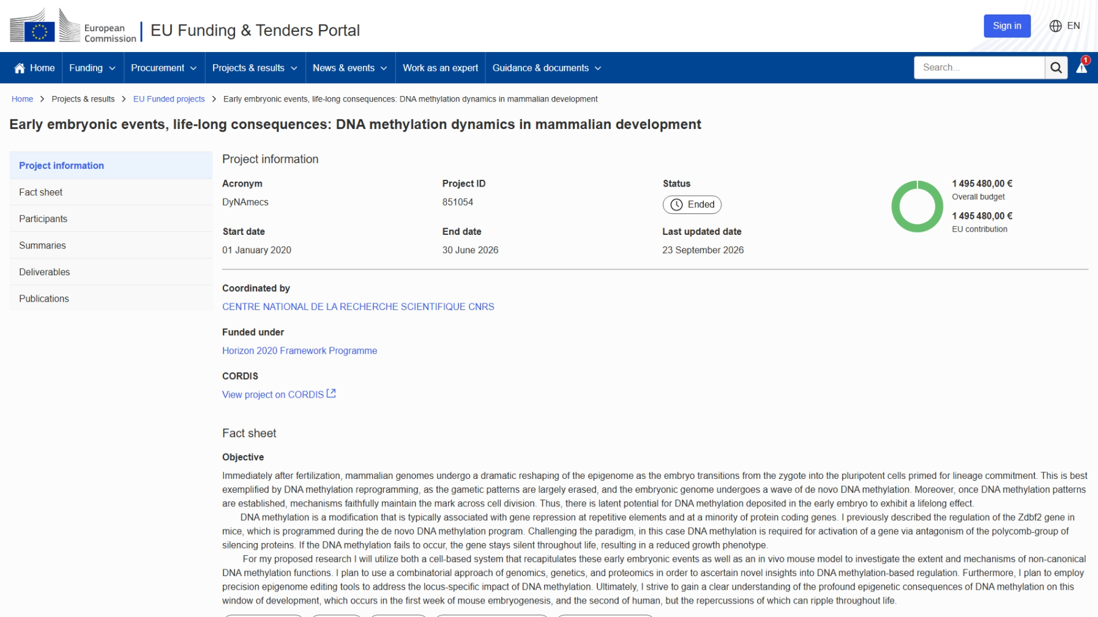
Example of an EU-funded project
EU funded projects

Slide 49
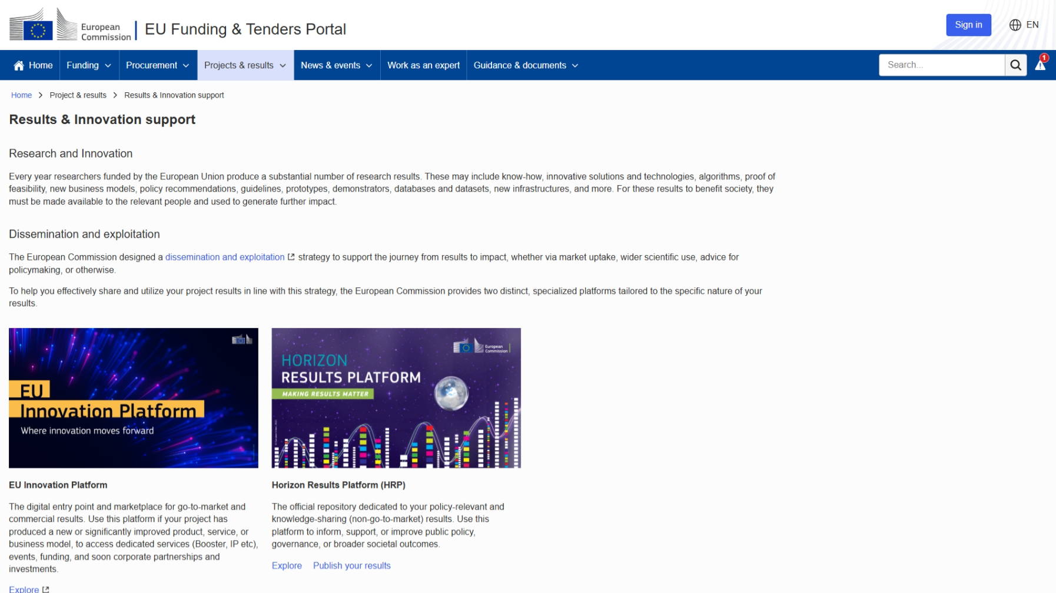
Research & Innovation support
Publish results about your project
PCoCo
CoCo
PaCo

Slide 50
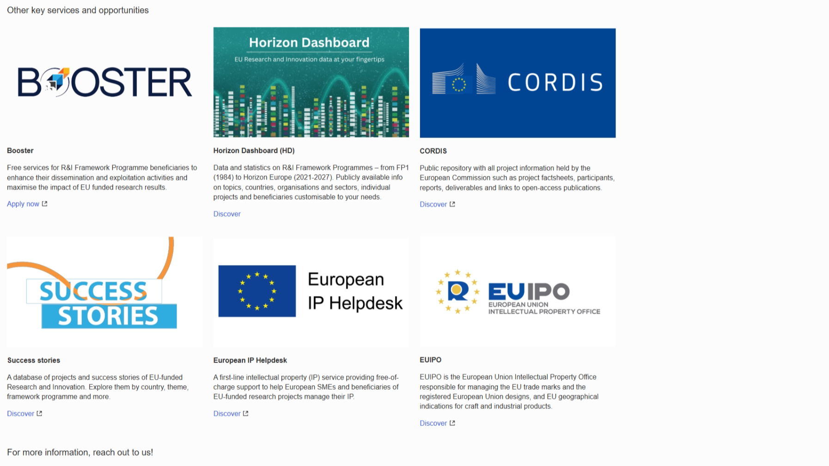
Research & Innovation support (continued)
Research & Innovation support

Slide 51
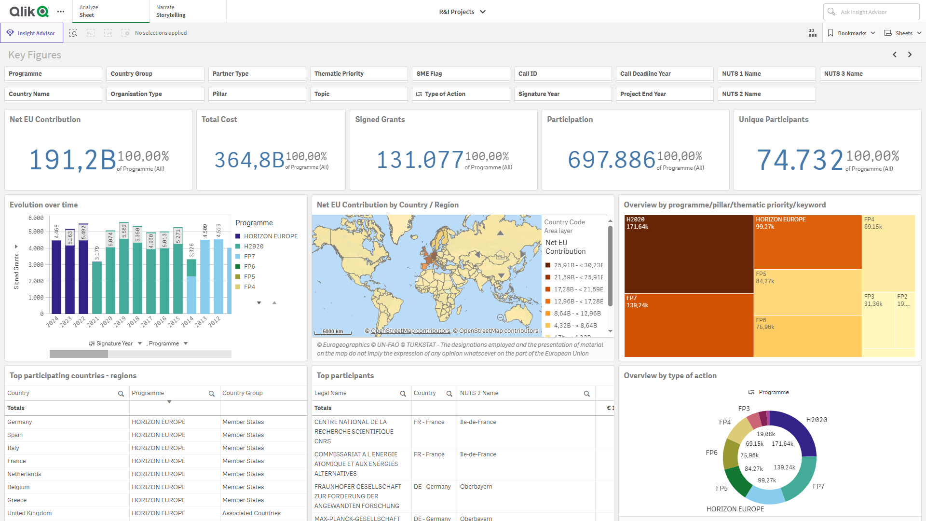
Horizon Dashboards
Obtain more fine-grained results
by using the filters

Slide 52
Help!
Feeling lost?

Slide 53

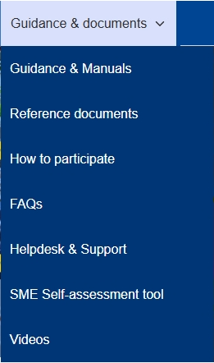
Need help?
Guidance & Manuals
  Access the Online Manual (guide for business processes)
  Access the IT How To wiki (guide for IT processes)
FAQs
Helpdesk & Support
Videos

Slide 54
Research Enquiry Service
For questions about research and Horizon Europe,
you can contact the Research Enquiry Service via the webform:
https://research-and-innovation.ec.europa.eu/contact-us/
research-enquiry-service_en

Slide 55
Thank you
Olivier.MARGANNE@ext.ec.europa.eu
© European Union 2026
Unless otherwise noted the reuse of this presentation is authorised under the CC BY 4.0 license. For any use or reproduction of elements that are not owned by the EU, permission may need to be sought directly from the respective right holders.

